Slide 1
Does excessive sitting negatively impact student metabolic health? A cross-sectional study on UNC students
Team3: Alexander Pomeroy, Chenghao Wang, Qianhui Yang, and Yue Yang
April 22, 2020
Notes:
Sections should include:
Intro (5 points),
Methods (5 points),
Results (5 points), and
Discussion (10 points),
with the remaining 5 points assigned for presentation style and format.

Slide 2

Table of contents
Introduction
Method
Result
Discussion

Slide 3
Introduction
Uninterrupted prolonged sitting could increase the risk of overweight and other commonly comorbid diseases.
The trend of uninterrupted prolonged sitting is rising due to working and studying in front of the computer and high risk of sitting during leisure time.
Studying the negative impact of prolonged sitting on health could give us insight into treatment strategies.
Targeted interventions could potentially prevent students from uninterrupted prolonged sitting.
Notes:
Uninterrupted prolonged sitting could increase the risk of obesity and many other commonly comorbid health pathologies, including cardiovascular disease and metabolic syndromes such as Type II diabetes (Balducci et al. 2017). Currently, college students tend to sit more and more hours than before (Moulin et al. 2019). The increased sitting time is likely caused by the surge in time working and studying in front of the computer. Due to the high stress of class work, college students are also at a high risk for sitting during leisure time (CITATION). This can result in high amounts of sitting per day, reducing caloric expenditure and increasing the risk of obesity (Villablanca et al. 2015).
Therefore, it would be highly beneficial to study the effect of prolonged sitting on health issues and start to intervene among college students to prevent chronic disease as soon as possible.

Slide 4
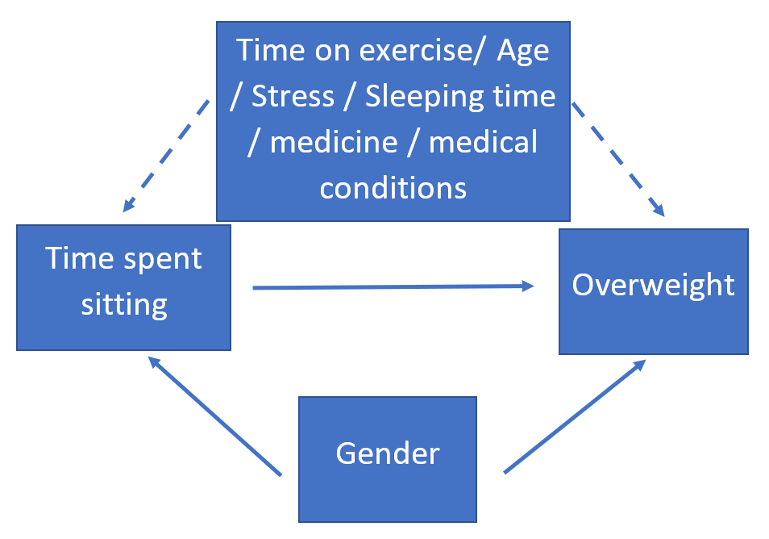
Methods
Study design: retrospective cross-sectional Questionnaires: Qualtrics, Mass email system 52 valid responses (0.1827%) Statistical Analysis: Crude odds ratio logistic regression
Notes:
Data was collected by delivering questionnaires through the campus email system from March 23rd, 2020 to April 19th, 2020.
Data cleaning by R. Data analysis by SAS and EpiInfo.
We computed crude OR and adjusted OR with log reg

Slide 5
Table 1. Prevalence of Sitting, Obesity, and Key Potential Confounding Variables in UNC Students (n=52)
Variable | Response | N (%) (or Mean ± SD)
Exposure (uninterrupted prolong sitting)* | non-prolong sitting (average<8h, max<12h ) | 27 (51/92%)
 | prolong sitting (average=>8h, max=>12h) | 25 (48.08%)
Outcome (overweight) | Yes | 22(42.3%)
 | No | 30 (57.69%)
Covariate (exercise) | average hours spent exercising every week | 5.89 ± 3.97
Age | Age in years | 26.74 ± 8.18
Gender | Male | 13(25%)
 | Female | 37(71.5%)
Stress | non or moderate | 9(17.31%)
 | medium to extreme | 43(82.69%)
Descriptive Statistics
Notes:
Avg: average hours spent sitting every day during three months prior to the survey
Max: maximum hours spent sitting during three months prior to the survey
Overweight, BMI (Body mass index) >=25
Hours spent exercising every week during 3 months prior to the survey
Age

Slide 6
Result 0 (Odds ratio for overweight versus ...)
Hours sitting per day 1.10 (0.84, 1.45)
Hours sitting longest per day 1.16(0.93,1.44)

Slide 7
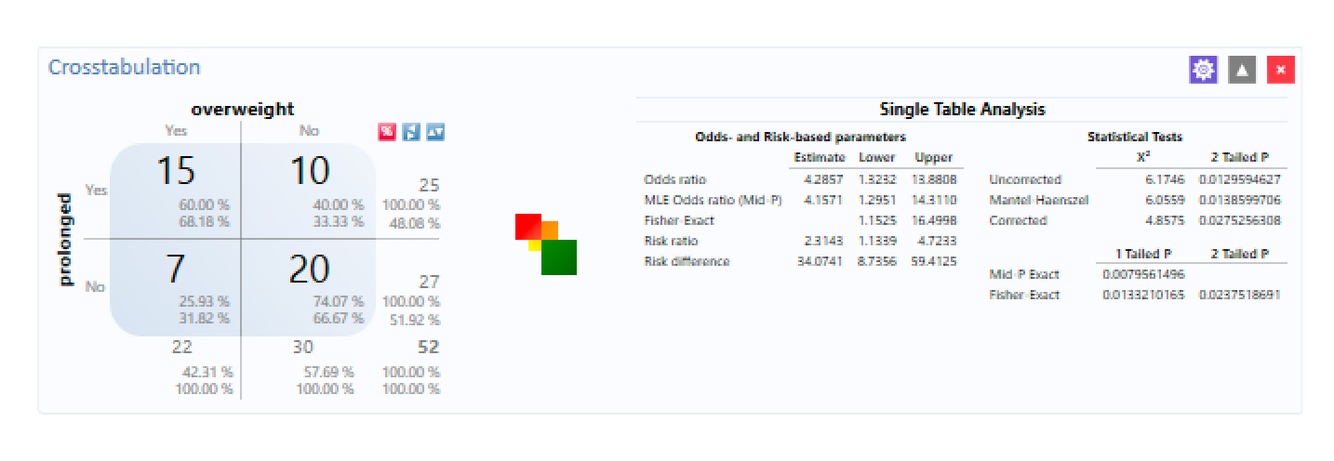
Result 1 (Crude Odds Ratio)
 | non-overweight | overweight | total
non-Prolonged sitting | 20 | 7 | 27
prolonged-sitting | 10 | 15 | 25
total | 30 | 22 | 52
Crude odds ratio of overweight versus prolonged sitting is 4.286
95% CI [1.323, 13.88]
95% CI does not include 1, thus significant

Slide 8
Method 1: percent change method
Crude OR (overweight versus prolonged sitting): 4.2857, 95%CI[1.3232, 13.8805]
Adjusted OR (gender): 6.7769, 95%CI[1.6267, 28.2336]
Adjusted OR (age): 11.000,95%CI[0.8456,143.0939]
Adjusted OR (hours exercising per week): 4.5481, 95%CI [1.3294, 15.5597]
Adjusted OR (hours sleeping per day): 4.5601, 95% CI [1.2744, 16.3174]
Adjusted OR (stress): 4.0242 [1.2184, 13.2915]
The confounder found is gender, whose percent change for OR is 58.13%,

Slide 9
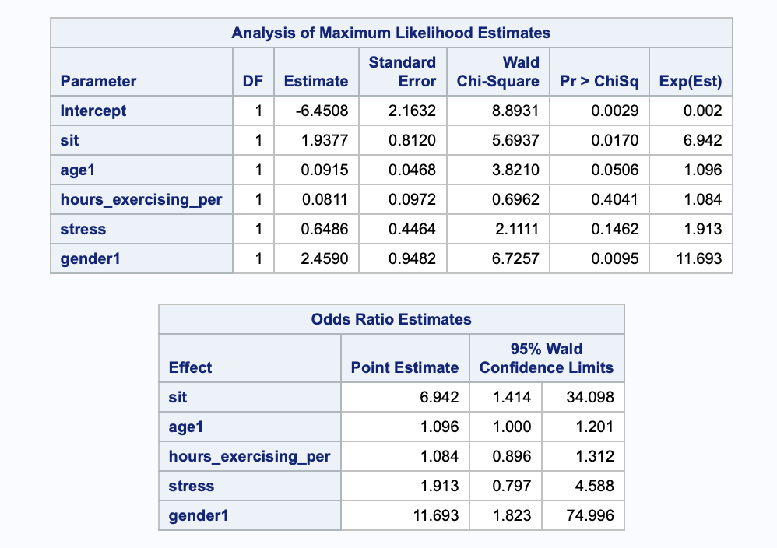
Result2: Logistic regression
Prolonged sitting is significant associate to overweight;
Odds ratio for prolonged sitting is 6.942, with 95%CI(1.414, 34.098)
Among the model, gender and age (marginal significant) are significant associate to the overweight.

Slide 10
Method 2: Model building
Table 2. Association between prolonged sitting and overweight among UNC undergraduate students, Spring 2020, n=52
 | Crude | 95%CI | Adjusted | 95%CI
Prolonged sitting | 4.286 | 1.323,13.881 | 7.029 | 1.674, 29.515
*>=8 hr average sitting and >= 12hr longest sitting **Adjusted for gender

Slide 11
Discussion
No significant association between the average sitting hour group or long sitting hours group and being overweight
No significant association between the prolonged sitting hour group and being overweight
Significant association was found between the students engaged in prolonged sitting (longest >= 12 hours per day and average >= 8 hours per day) and being overweight (OR: 4.286, 95% CI: [1.3232, 13.8805])
Limitations:
Low sample size, which leads to small statistical power and low reliability.
Questionnaire could cause some recall bias
Notes:
Our results showed no statistically significant association between those who sat for an average amount of time, which we defined as less than 12 hours per day and being overweight. Furthermore, there was no association between the high sitting group, which we defined as sitting more than 12 hours per day and being overweight. There was also no association between those who engaged in prolonged sitting, which we defined as a bout of sitting for greater than 8 consecutive hours, and being overweight. However, there was a statistically significant correlation between those with high sitting and a bout of sitting longer than 8 hours and being overweight (p = 0.0264). This could indicate that those who are doing the most sitting do have the greatest association with being overweight. Future research could investigate the relationship between high sitting per day and continuous bouts of sitting to determine if those factors have an interaction or covariance and how that interacts with
There were some factors in our study which could have influenced our conclusions, such as our relatively small sample size. For that reason, our conclusions could have been underpowered. Also, the fact that we used a questionnaire, rather than activity trackers such as actigraphs, could have introduced recall bias for those who sat. Some people may not properly recall how much they sit per day, because they are likely estimating rather than measuring their sitting behavior.

Slide 12
Discussion: confounder
Gender is the only confounder that has been found in our study.
Percent change between Crude and Adjusted OR: 58.13%
Odds ratio when adjusted for gender: 6.7769, 95%CI[1.6267, 28.2336]
Confounder limitations
Medical conditions and prescriptions could be important, but it is hard to adjust for these factors in data analysis.
Eating habit is also an important factor related to BMI. Our findings contrasted research that shows eating behaviours are common when people are sitting, which could increase the probability of weight gain.
Notes:
Furthermore, we did find that gender was a covariate, specifically as a confounding variable for being overweight. The percent change between the crude and adjusted odds ratio was 58.13% when adjusted for gender, which indicated that it was a confounding variable. Also, we had a few confounding variables which were limited, in that we could not quite measure them properly. For example, we had a free answer space in our questionnaire for medical conditions and prescriptions, but obtained a large and varied list. If we could better group medications, and had a medical expert on our team to help with it, we might have obtained different results. Similarly, we found eating habits to be non-significant to being overweight, but this goes against prior research and our results were varied, which could be why we got different results.

Slide 13

Question?

Slide 14
Reference
Tremblay MS, Aubert S, Barnes JD, et al. Sedentary Behavior Research Network (SBRN) - Terminology Consensus Project process and outcome. Int J Behav Nutr Phys Act. 2017;14(1):75. Published 2017 Jun 10. doi:10.1186/s12966-017-0525-8
Restaino RM, Walsh LK, Morishima T, et al. Endothelial dysfunction following prolonged sitting is mediated by a reduction in shear stress. Am J Physiol Heart Circ Physiol. 2016;310(5):H648–H653. doi:10.1152/ajpheart.00943.2015
Jia B, Nussbaum MA. Influences of continuous sitting and psychosocial stress on low back kinematics, kinetics, discomfort, and localized muscle fatigue during unsupported sitting activities. Ergonomics. 2018;61:1671-1684.
Ekelund U, Steene-Johannessen J, Brown WJ, et al. Does physical activity attenuate, or even eliminate, the detrimental association of sitting time with mortality? A harmonised meta-analysis of data from more than 1 million men and women. Lancet. 2016;388(10051):1302-1310. doi:10.1016/S0140-6736(16)30370-1
Ganasegeran, K., Al-Dubai, S.A., Qureshi, A.M. et al. Social and psychological factors affecting eating habits among university students in a Malaysian medical school: a cross-sectional study. Nutr J 11, 48 (2012). https://doi.org/10.1186/1475-2891-11-48
Bargiota, A., Delizona, M., Tsitouras, A. et al. Eating habits and factors affecting food choice of adolescents living in rural areas. Hormones 12, 246–253 (2013). https://doi.org/10.14310/horm.2002.1408

